Slide 1
Covid 19 disinfecting robot
Final presentation

Slide 2
Design process
The projects aim was to create a fully functioning autonomous disinfecting robot for public transport areas. This was changed over the life of the project to only create the end effector.
Initially the majority of the focus was on creating a Requirement specification which lead to hypothetical requirements from non existent customers.
After that the project turned more towards a rapid prototyping approach. There was not enough iteration of project to create a robust project but it allowed the exploration of the majority of the subjects studied in this course.

Slide 3
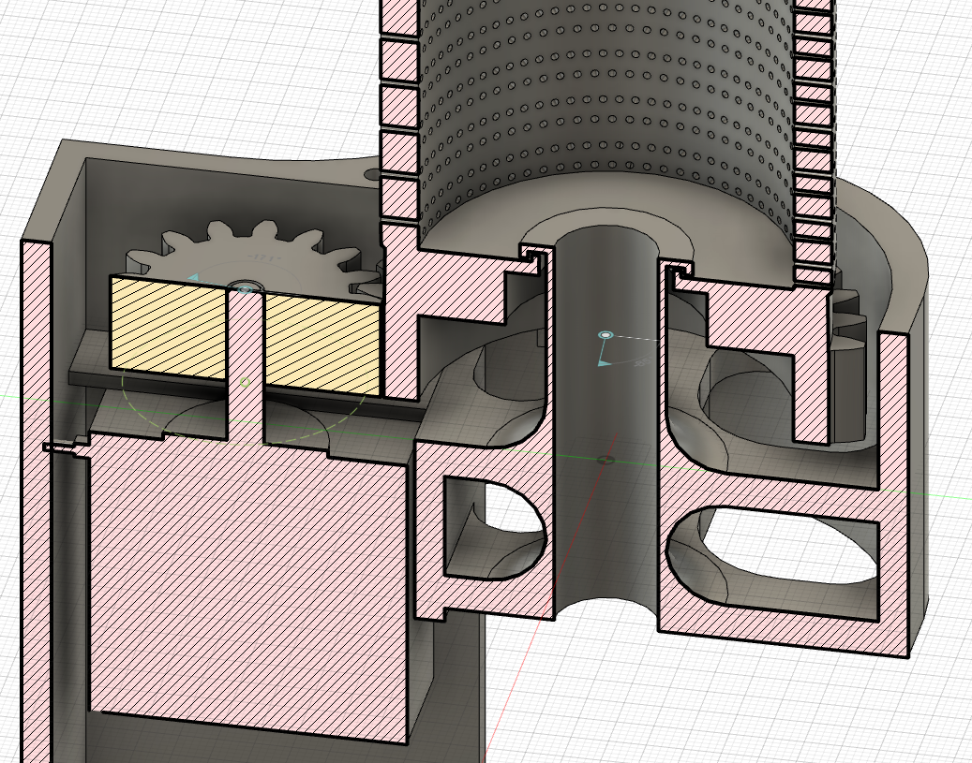
CAD – Computer Aided Design
With the use of Fusion 360 an initial version of the End Effector was created.
This enabled some initial understanding of the problems with the idea of using centripetal force to carry the cleaning liquid into the microfiber glove placed over the meshed core such as,
The need to displace the motor form the axis of rotation to allow space for the pipe
Assembly issues
Access material
Moisture

Slide 4
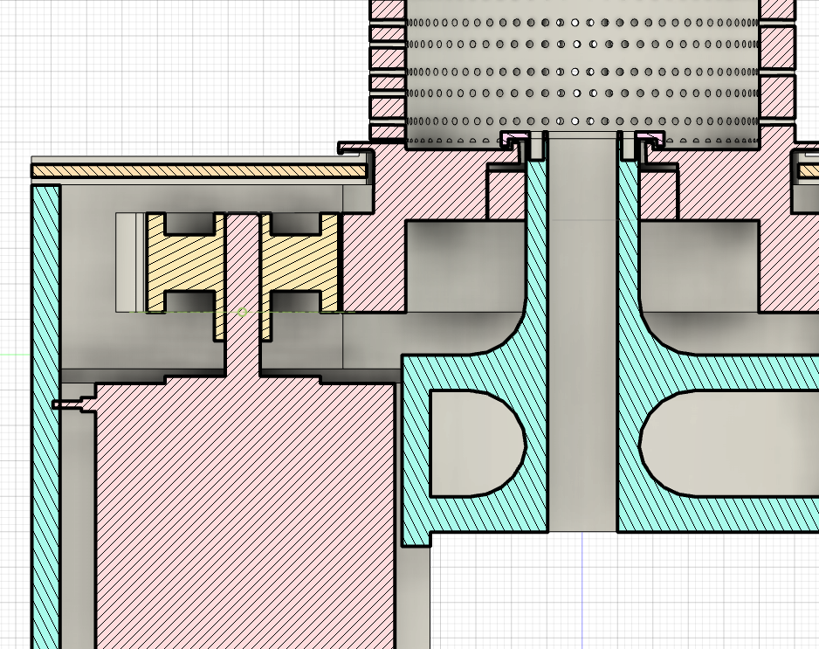
CAD – Computer Aided Design
These issues were then addressed by the next iteration.
Access material was removed from the driver gear
The housing lid was split in 2 and fitted together with a ridge in a groove for moisture protection
The moisture protective lid on the pipe shaft was made detachable.

Slide 5
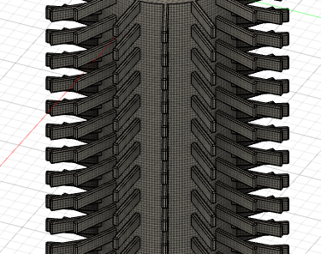
Research skills, Speed and Torque calculations.
A multitude of papers and online sources had to be looked through to be able to calculate the torque needed to spin the core with a microfiber glove on it.
Comparisons were made with the robots using the UVC light as disinfection method.

Slide 6
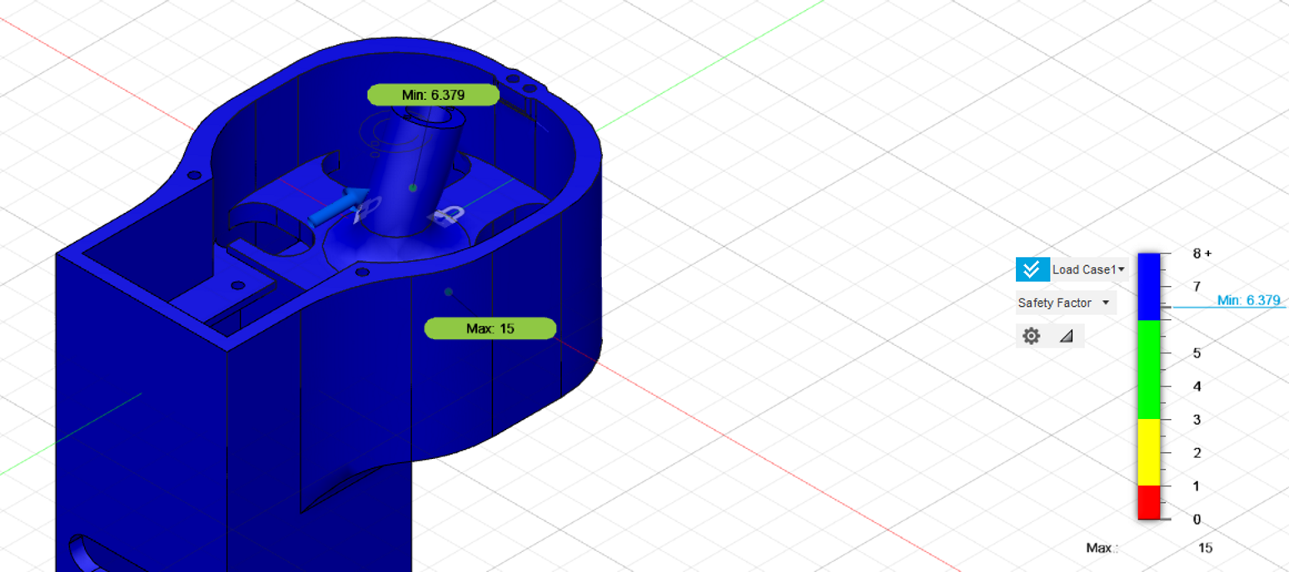
Finite Element Analysis
The finite element analysis was carried out using Fusion 360. This allowed to explore the properties of materials such as Young’s modulus and Tensile strength as well as how the safety factor is used in design.
The analysis was carried out on the weakest point of the design. The elements were modified so the safety factor will be high enough to compensate for the filling in the 3D printed part.

Slide 7
Materials
Porperties | ABS | PLA
Yield stress | 43.3 MPa | 44.8 MPa
Part accuracy | Printing details down to 0.8 mm | Printing details down to 0.8 mm
Strength | Improved ductility Higher flexural strength Bigger elastic region
Biodegradability | Non biodegradable | Biodegradable (under correct circumstances)
Price | ~£25.00/ 1kg of 1.75mm Spool | ~ £25.00/ 1kg of 1.75mm Spool
To understand the implications of the finite element analysis and to calculate for pricing and prototyping time the 2 most commonly used 3D printing material was researched.
It was determined that due to it’s better durability and similar price the ABS is the right choice for the part.

Slide 8
Conclusion
There was potential in the initial project idea and a lot more could have been achieved given some different circumstances.
Positive
Was able to touch on most of the modules teaching material (CAD, Structural Analysis, Research)
Negative
Bad project management (on the project team’s part)

